Slide 1
Mini-project-2
By Winnie Wetthasinghe
05/05/2021

Slide 2
Introduction & project objective
According to the World Health Organization (WHO) stroke is the 2nd leading cause of death globally, responsible for approximately 11% of total deaths.
The ability to predict whether someone might get a stroke in future or not is extremely useful to save lives.
This project focuses on implementing a ML model that can predict whether a patient is likely to get stroke based on patient’s health records.

Slide 3
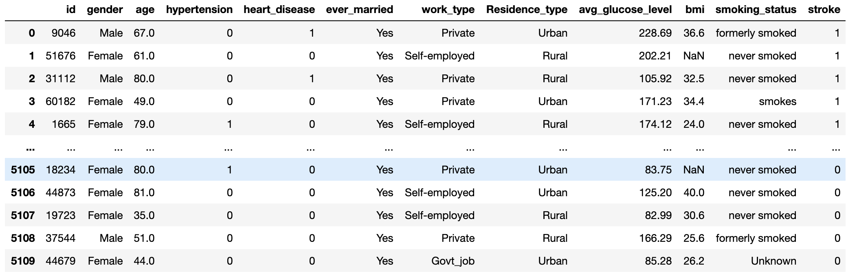
About the dataset
The predict whether a patient is likely to get stroke based on the input parameters like gender, age, various diseases, and smoking status. Each row in the data provides relevant information about the patient.

Slide 4
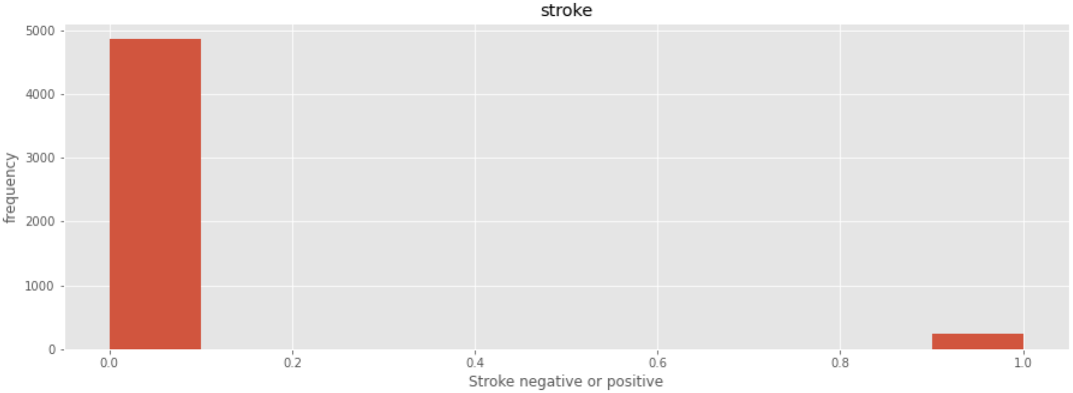
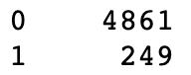
Target variable
‘Stroke’ selected
Tells us which type of supervised learning algorithms to use.
Binary classification
Logistic Regression, Support Vector Machine, Naïve Bayes, Perceptron
Type of performance evaluation matrices to use
Outputs are imbalanced, 95.13% “no stroke” and 4.88% ”stroke”

Slide 5
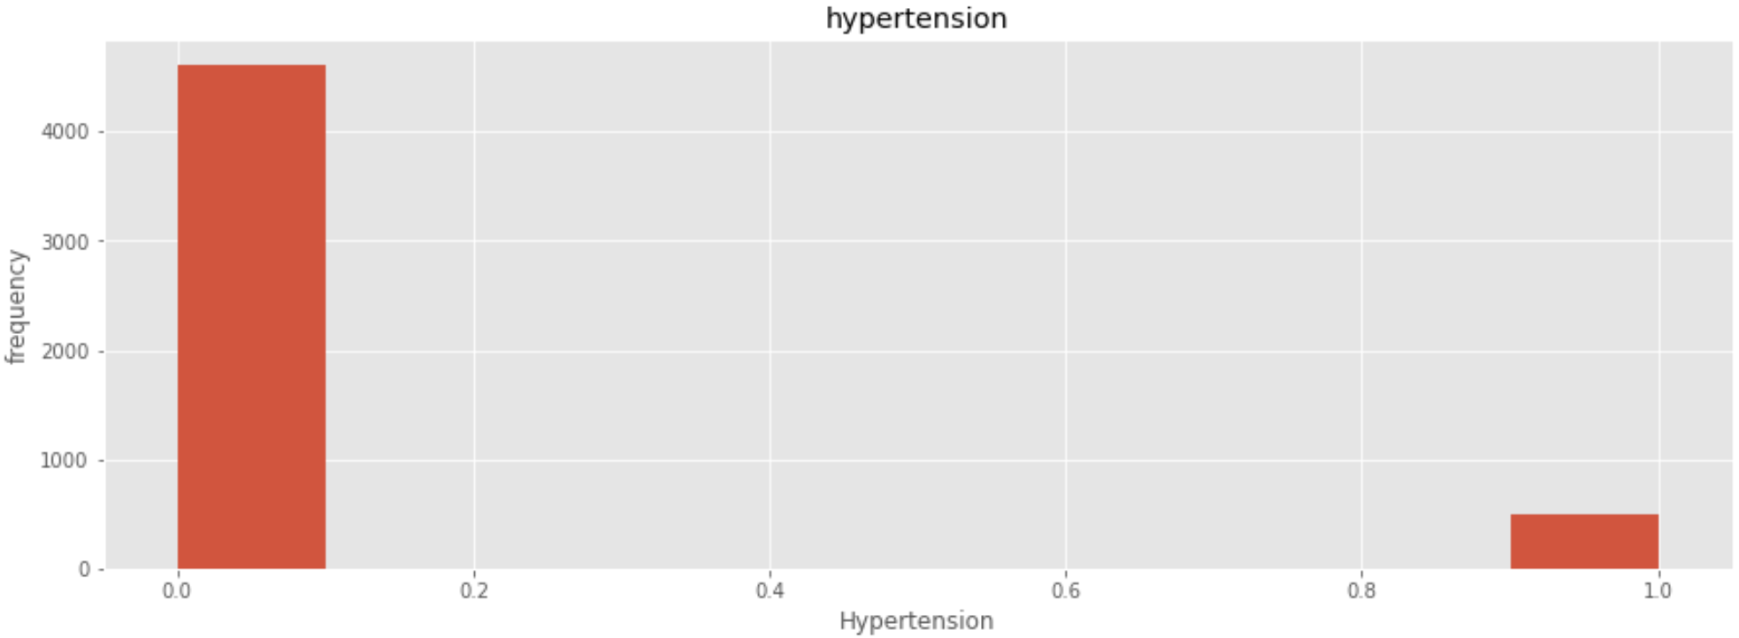
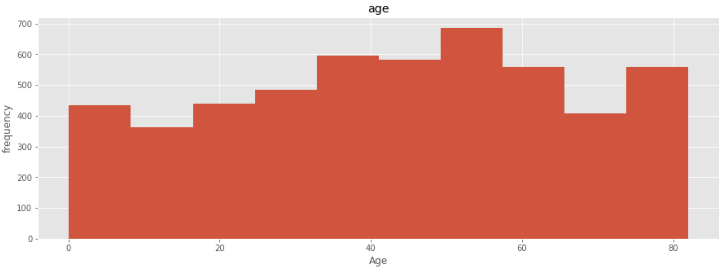
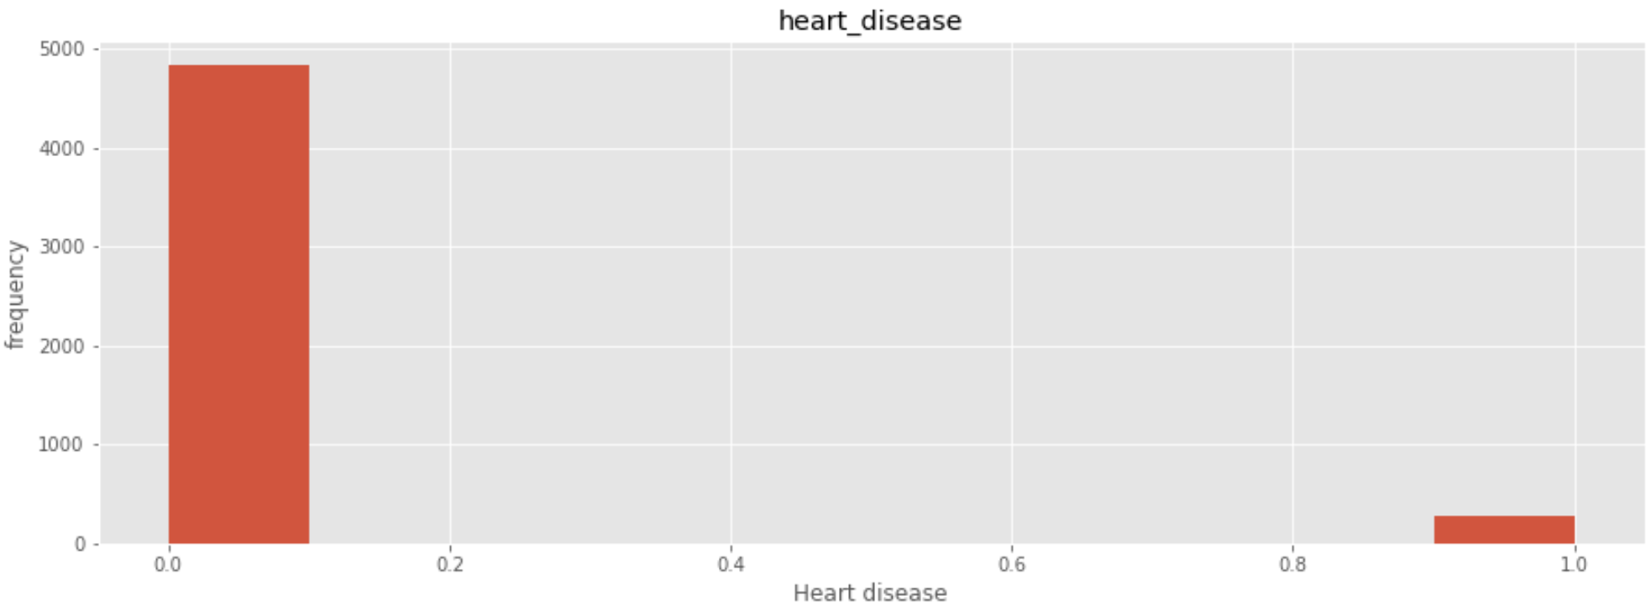
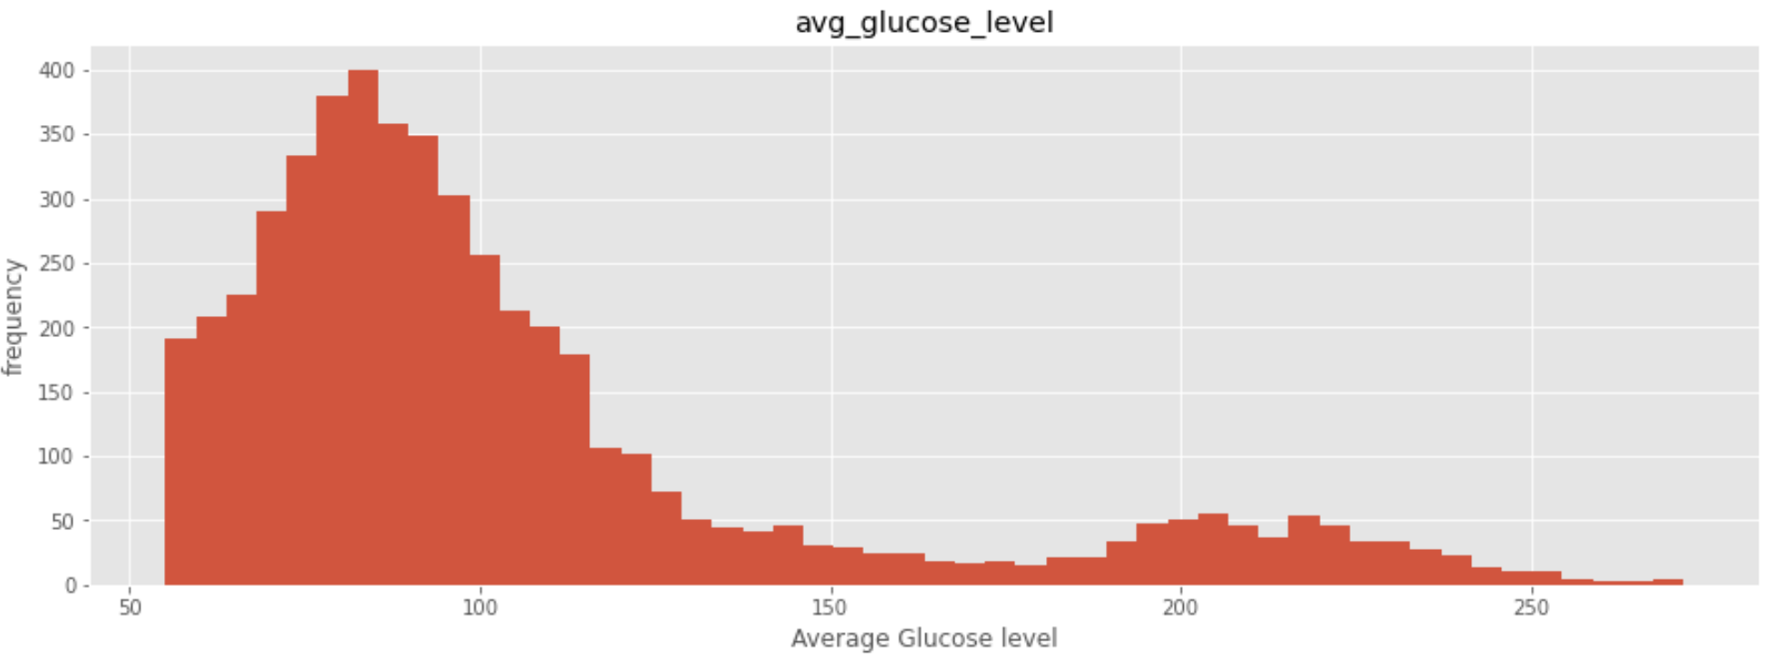
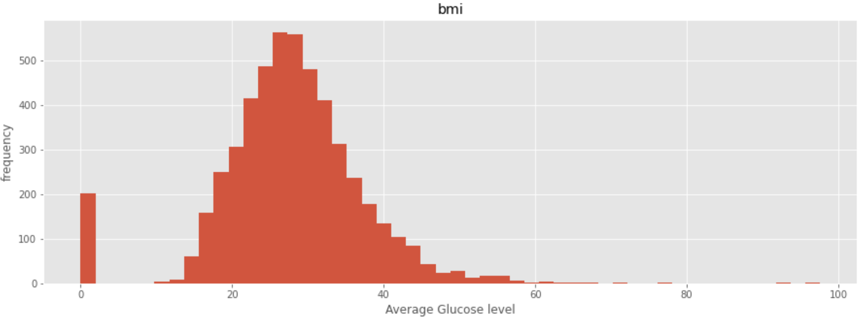
Analysis & visualization of input variables

Slide 6

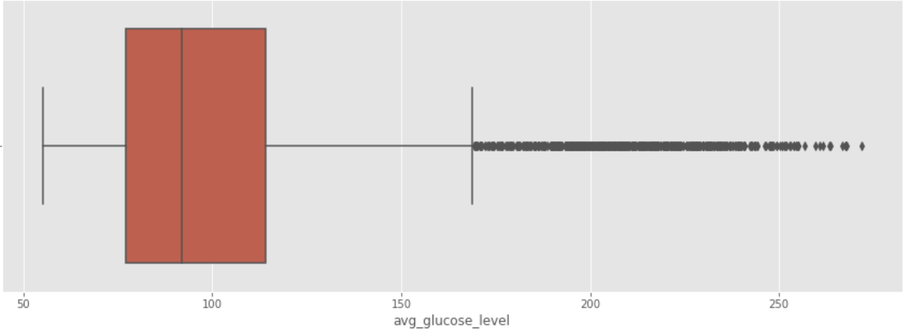
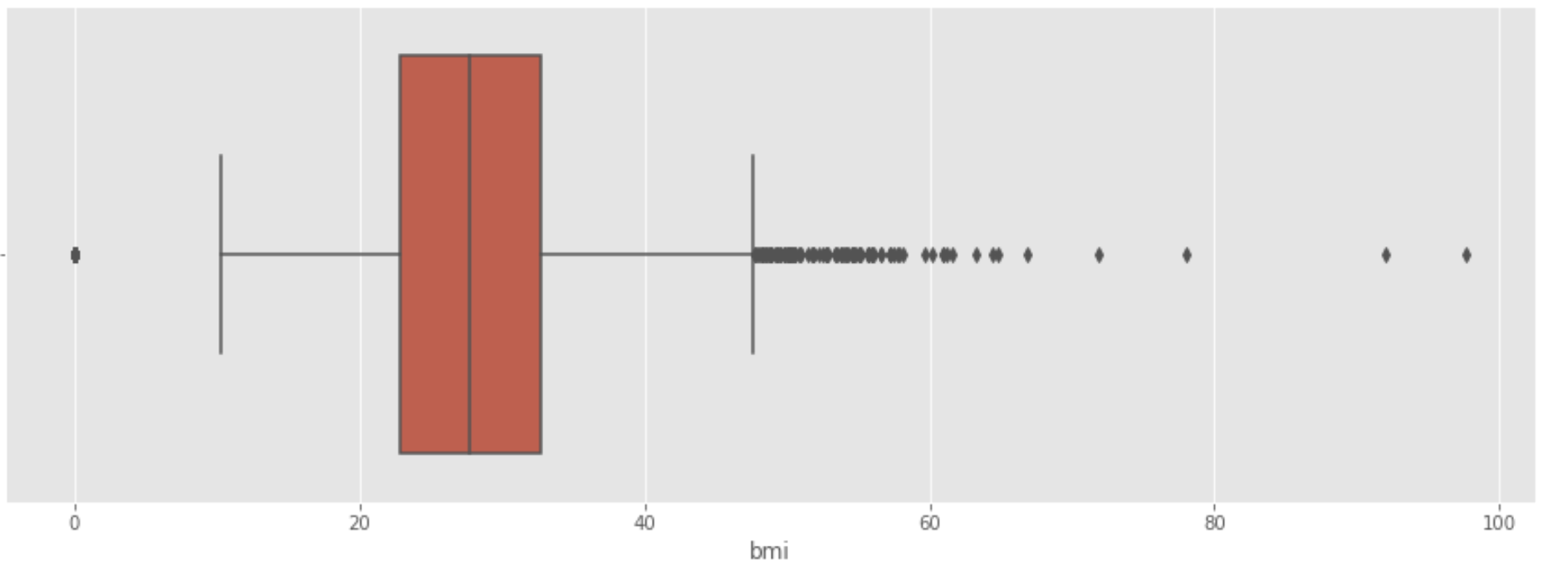
Detecting outliers
Removing outliers will cause to lose significant amounts of data and may not be good for the dataset for modelling.

Slide 7
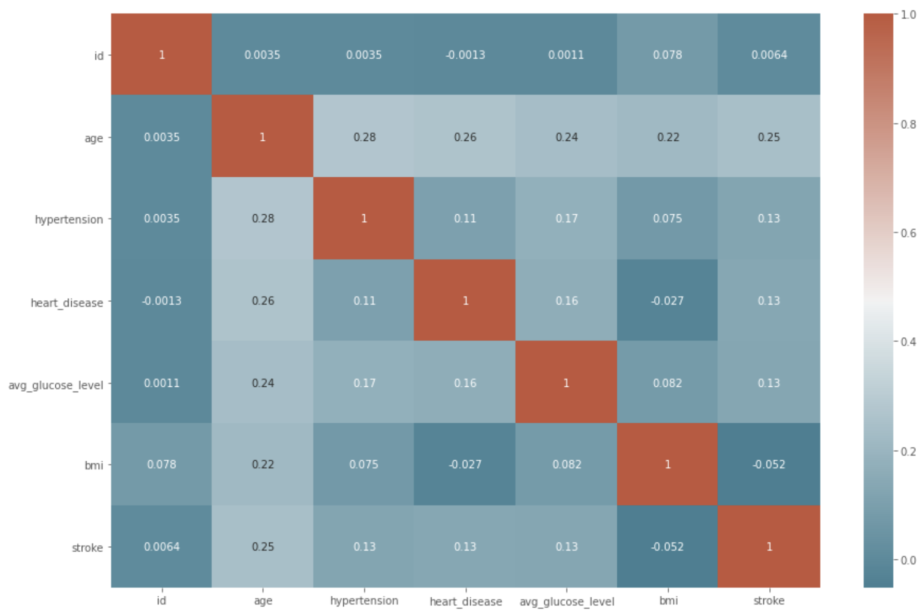
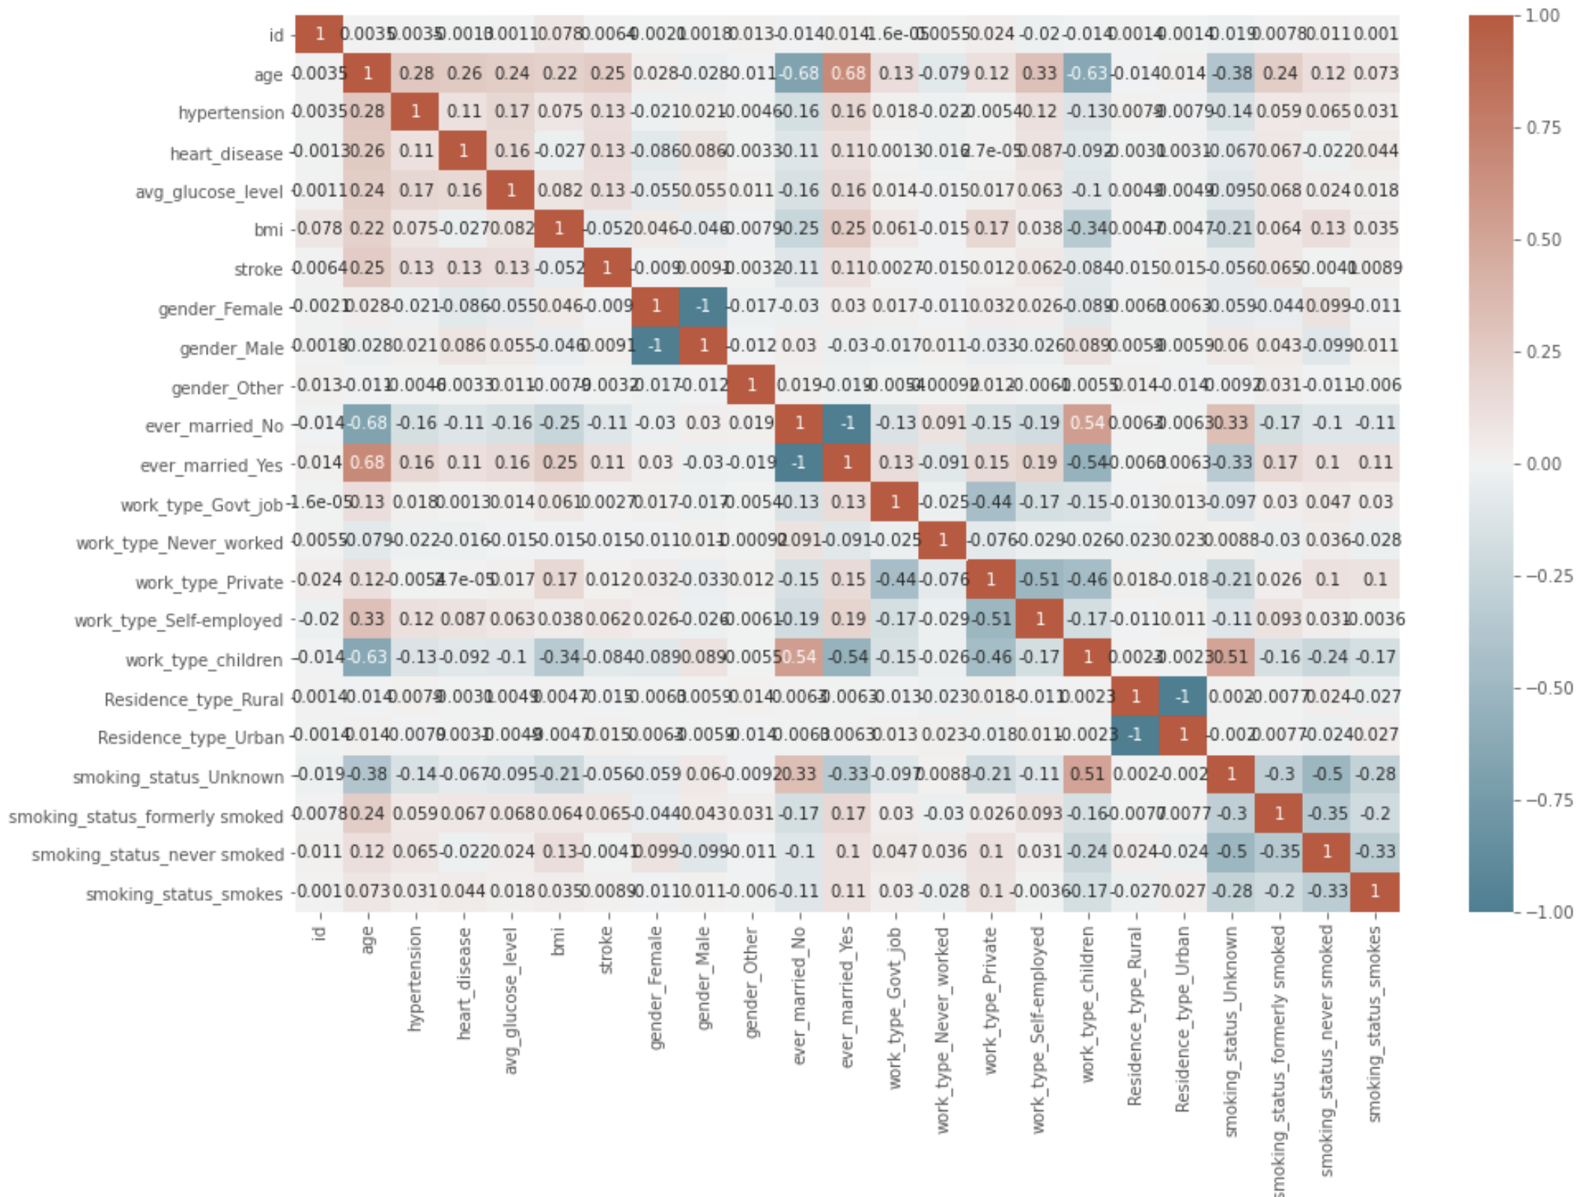
Feature selection & feature engineering

Slide 8
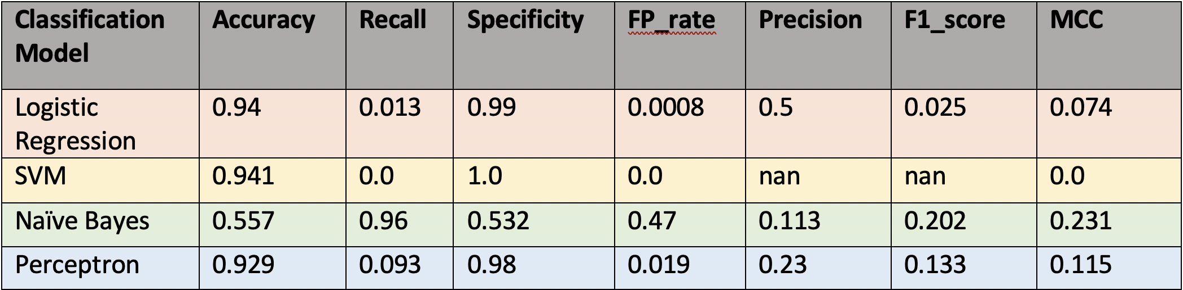
Binary Classification Comparison

Slide 9
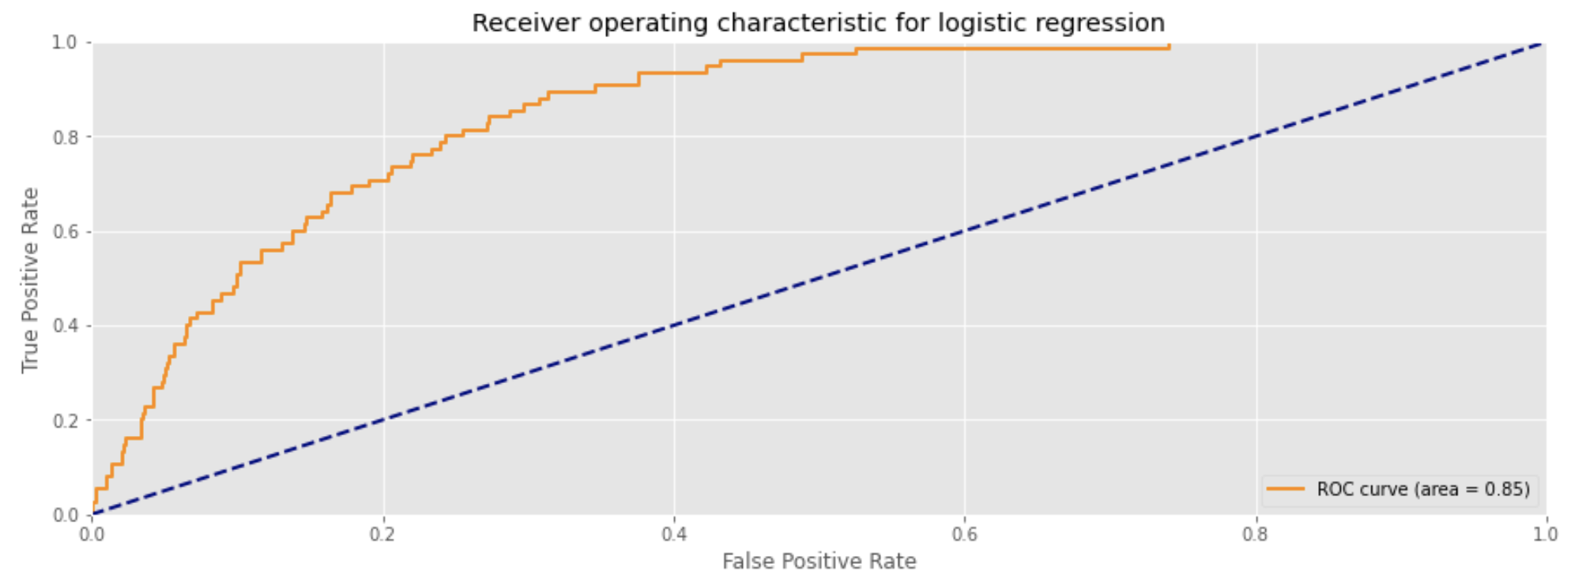
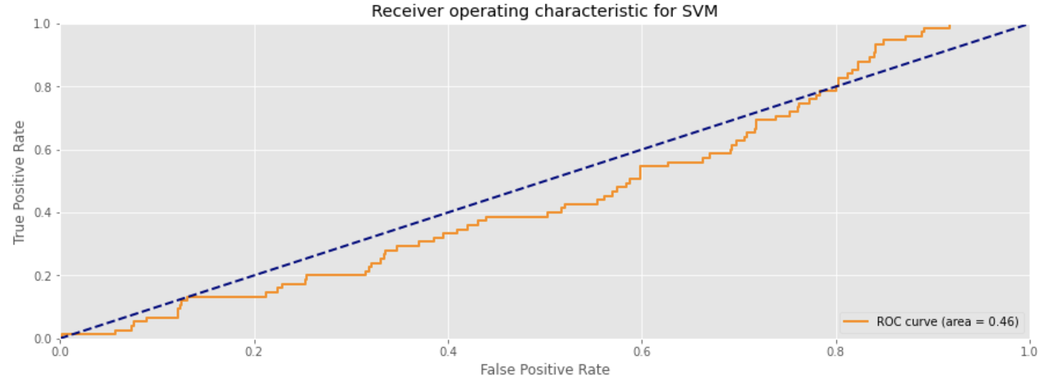
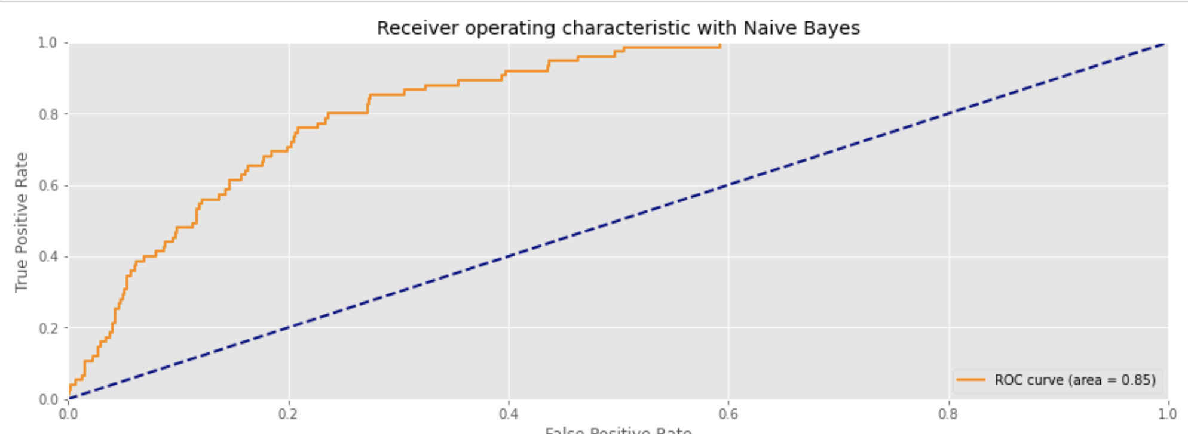
ROC Curves

Slide 10
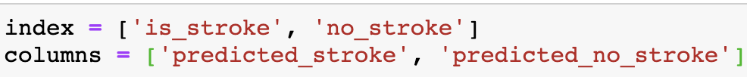
Evaluate based on performance metrices
Accuracy- How many were correctly diagnosed as likely to have a stroke.
Recall- Proportion of patients that actually will have a stroke were diagnosed by the algorithm as getting a stroke.
Specificity- Proportion of patients that will not have a stroke, were predicted by the model as no_stroke.
False Positive rate- an outcome where the model incorrectly predicts the is_stroke class when it is no_stroke
Precision- proportion of patients that we diagnosed as is_stroke, actually will have a stroke

Slide 11
Evaluate based on performance metrices cont.
F1-score- metric is a good choice for the imbalanced classification.
Situation where we must give equal importance to both the classes – classify having stroke or no_stroke. We have an imbalanced classification problem.
A model with high accuracy will know to correctly identify all stroke patients but will have trouble identifying no stroke patients. But if we select a model that has a high F1 score, it would perform better in classifying no-stroke from stroke.

Slide 12
Evaluate based on performance metrices cont.
MCC (Matthews Correlation Coefficient)-mcc is extremely good metric for the imbalanced classification and can be safely used even classes are very different in sizes

Slide 13
Result & Conclusion
So, from the above predicting models and based on performance metrices evaluation, we select Naïve Bayes model to be the most suitable to predict future stroke patients.

Slide 14

Thank you!

